Slide 1
Lab 7-2
Coding the UML specification
ctor and dtor practicing II

Slide 2
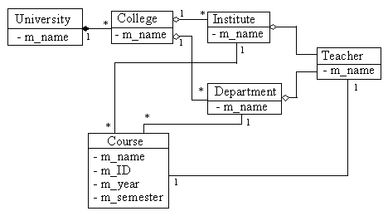
Class diagram

Slide 3
CTeacher
m_name
m_course
CTeacher::CTeacher(ifstream &infile)
CTeacher::~CTeacher()
void CTeacher::print(ostream &os)
void Cteacher:: queryTeacherBasicsByName(string name, ostream &os)

Slide 4
CCourse
m_name
m_ID
m_year
m_semester
m_teacher
CCourse::CCourse(ifstream &infile)
CCourse::~CCourse()
void CCourse::print(ostream &os)

Slide 5
CDapartment
m_name
m_teacher
m_course
CDapartment::CDapartment(ifstream &infile)
CDapartment::~CDapartment()
void CDapartment::print(ostream &os)
void CDapartment:: queryTeacherBasicsByName(string name, ostream &os)

Slide 6
CInstitute
m_name
m_teacher
m_course
CInstitute::CInstitute(ifstream &infile)
CInstitute::~CInstitute()
void CInstitute::print(ostream &os)
void CInstitute:: queryTeacherBasicsByName(string name, ostream &os)

Slide 7
CCollege
m_name
m_department
m_institute
CCollege::CCollege(ifstream &infile)
CCollege::~CCollege()
void CCollege::print(ostream &os)
Void CCollege:: queryTeacherBasicsByName(string name, ostream &os)

Slide 8
CUniversity
m_name
m_college
CUniversity::CUniversity(ifstream &infile)
CUniversity::~CUniversity()
void CUniversity::print(ostream &os)
static void University::unitTest()
bool University::query()
void CUniversity:: queryTeacherBasicsByName(string name, ostream &os)

Slide 9
Delegation
CUniversity::queryTeacherBasicsByName
CCollege::queryTeacherBasicsByName
CInstitue::queryTeacherBasicsByName
CTeacher::queryTeacherBasicsByName

